Slide 1
Mojaloop Foundation Update
Paula Hunter
January 25, 2021

Slide 2
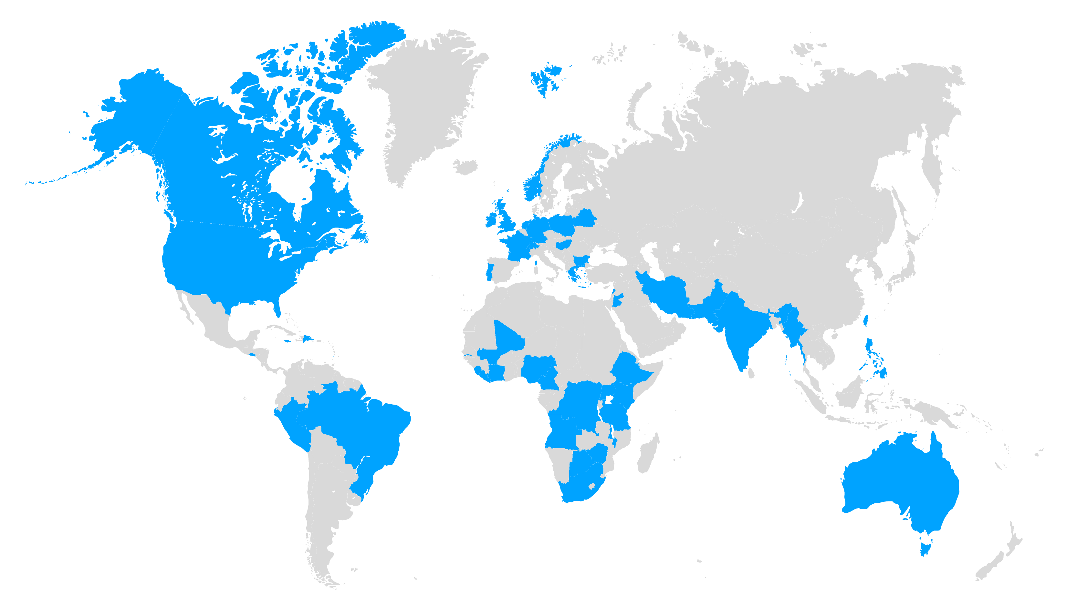
Welcome Mojaloop Community!
2016
520 days
368 days
362 days
361 days
659
6
47
10
Participants and growing!
Continents
Countries
Sponsor/
Promoter
Members
Notes:
Paula Hunter:
Let's talk a little bit more about our community. From the onset, we really wanted the Mojaloop community to be multinational, provide perspective around the globe with regard to this platform. [inaudible 00:17:26] our center of gravity for early work was to meet market needs in Africa, where there is a large percentage of unbanked and underserved individuals, but we have contributions and input from countries across the globe. We're up to over 650 participants in our community. We span six continents, 47 countries, and we have 10 sponsor-promoter members. So when we do those week-long planning sessions, community meetings, as I mentioned, we just finished one earlier in October, we get input from all over the globe from a wide range of participants. Whether it be digital financial service providers, central banks, implementers, Open-source developers. So, it's a very rich and robust community that's guiding us through our development.

Slide 3


Everyone Benefits
From an Economy that
Includes Everyone
Our Mission
Increase financial inclusion by delivering interoperable payment systems to enable digital financial services for all

Slide 4
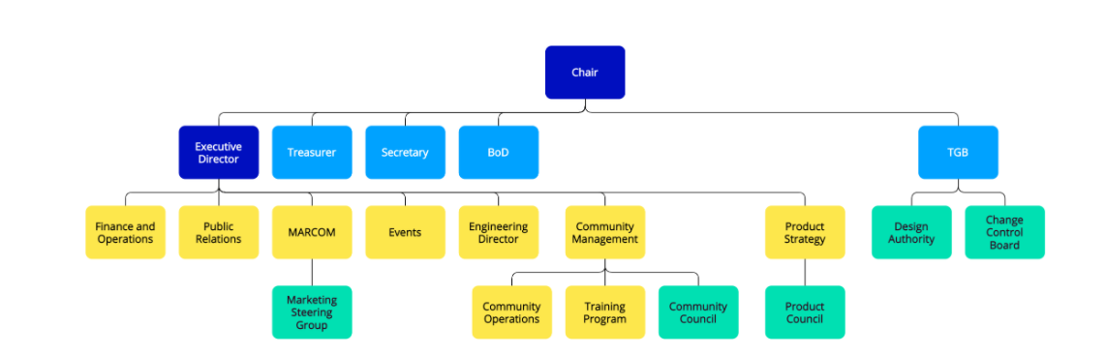
The Mojaloop Foundation Organization
Members
Staff
Community

Slide 5
Mojaloop Foundation Top Priority for 2021
Gain Traction!
How do we measure success?
Deployments
Progress on projects in process
Large scale deployments
New pilots

Slide 6
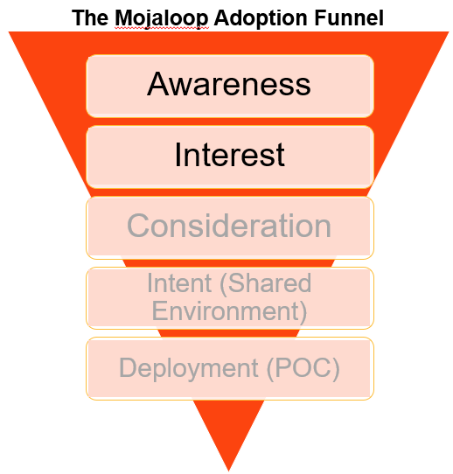
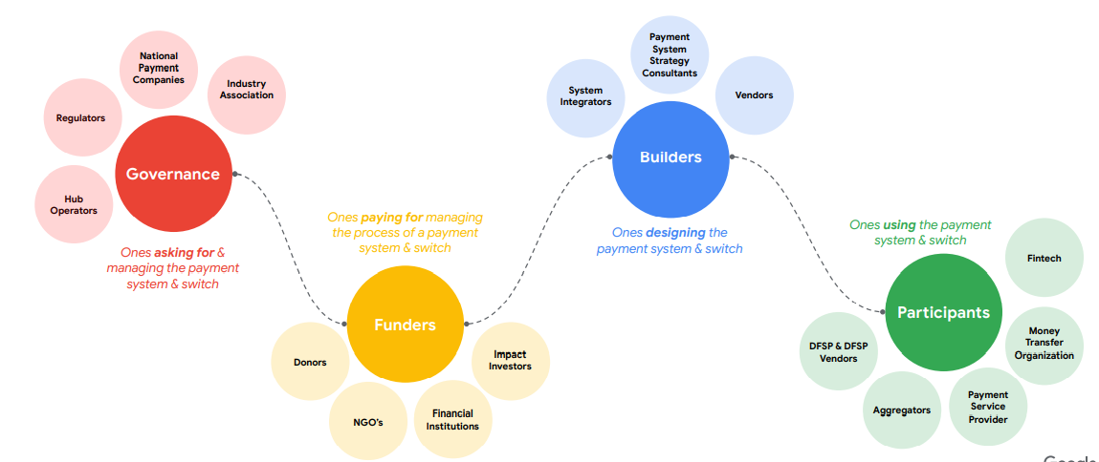
Objective: Increase Awareness A focus on what is needed to help advocacy conversations and to encourage those writing RFPs to think differently about what they need.
Deliverables:
White papers & opinion pieces on leading features – via Marketing Steering Group
Hosted Demos that showcase the end-to-end story key messages, to help less technical audience engage without needing 1:1 conversations
Simpler get started signpost documentation for multiple personas
Clarity on issues such as ISO20022 compatibility and our approach
Notes:
AFDB, EAC SIT WHERE? NGOS?
QR code – what models we’ve implemented and why
PISP
Open Agents – MFI loan repayments in time of COVID
Reconciliation and Liquidity position Automation – why it matters
Harnessing the power of open source for operational management (Grafana dashboards)
Our links/potential links to MOSIP – thinking about inclusive identity
PINS are broken – how might biometrics fit in a transaction authentication flow?
Why we’re different to messaging systems – the 2 phase transaction that guarantees funds movement

Slide 7
Objective: Increase Interest/Consideration Focus on a good first experience for any adopter team or service provider/vendors.
Deliverables:
Reduced barrier to entry such that a new entity doesn’t take 3-6 months to be effective.
Simpler get started signpost documentation for multiple personas
“Don’t make me think” - Get-Started-Quickly business process + reference UX thinking for hub (ideally aligned with IIPS)
Standardised packaged offers from the community for POC & standards adaptation work for legacy connection.
Notes:
Eg Using early adopters such as Applied Payments to ensure we are closing the right gaps

Slide 8
2021 will be the year of…
Cost Reduction
… as measured by the checklist of manual steps to go from “yes” to running a sufficiently complete hub, and the monthly operational cost at low traffic levels
Removing Friction
… as measured by the marketing funnel steps
Understanding and Resolving Gaps through the eyes of Adopters to enhance traction
... As measured by no of APIs & use cases being tested/reviewed at least to POC level, level of issues raised by adopters & resolved, & amount of code contributed back by POC projects
Confidence in our claim of Trustworthy, Quality & Credible
… as measured performance statistics the main code branch, and no of deals/Sandboxes/POCs/larger scale deployments that are running real money by year end… and of organic press mentions by influencer/adopter community advocating mojaloop
“Ready for Production”
Notes:
To date we have focused on coding metrics, volume of lines of code, volume of checkins, no of unit tests, etc
We need to add more metrics.

Slide 9
We can’t do it alone!

Slide 10









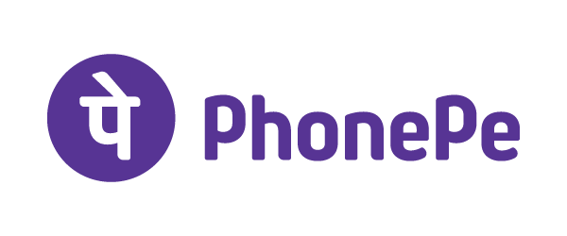



Thank you to our Members
One loop that brings digital financial services providers and the unbanked together for the benefit of all

Slide 11


















And our Product Council Participants
Notes:
Product council has been up and running for 4-5 councils now. The brands represented on the council are shown here. Key workstreams are running themselves in slack: slack signup link is on our website all are welcome to open meetings on Thursday 2:30pm GMT.

Slide 12
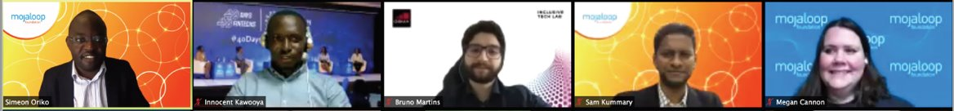
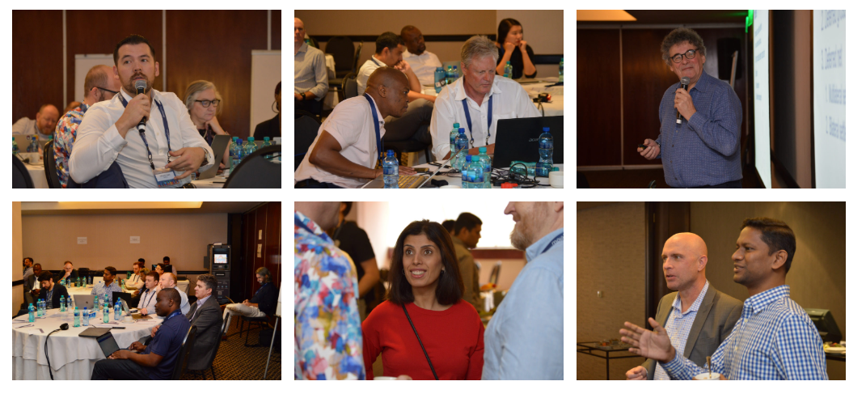
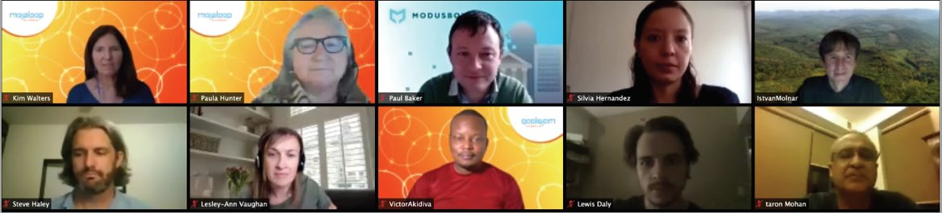
And the Mojaloop Community!

Slide 13


Reduce friction for adopters and contributors
Mojaloop Community Objectives
Attract and/or grow new constituencies of contributors
Diversify contributions

Slide 14


Raise Awareness of Mission and Mojaloop
- Use Cases
- Ways to Adopt
- Ways to Get Involved / Sponsor
MARCOM and Marketing Steering Group Objectives More Showing and Telling
Advocate for Adoption
- Central Banks / Government Offices
- DFSPs
- System Integrator Relationships
Grow the Global Mojaloop Community
- More quality contributors / members
- Increased community participation
- Collaboration with inclusion-focused orgs

Slide 15
How We Will Advance Awareness, Interest
2021 Programs
2021 Activities
2021 Measurement
PR
Press releases
Blogs / Bylined Articles
Media Relations
Member Spotlight Interview Series
# Release Views
# Traffic Back to Website
# Thought Leadership coverage, blogs and bylines
Content
Newsletters
Blogs / Podcasts
Adoption Tool Kit
Open & Click Through Rates / Newsletter list growth rate
Master presentation use # of country pitches
Presentation and one-pager use / high-level meetings
Repurposing podcast content into blogs to amplify message and increase website traffic and SEO
Digital
Emails
Social media
Video
Website / Training Section & Navigation
Increase in Audience Growth / Engagement / Total Views
Increase in email subscribers
Videos tend to be the top performers in social campaigns
During this time of no F2F meeting videos help us feel connected
Enhancement of navigation to more predominantly showcase all content pieces for easier access
Events
Community Meetings
Speaker Bureau
Conferences
Webinar series branded – demo & panel
# of speaking engagements / speakers
# of in-bound requests for speaking
# attendees and on-demand views of presontations, webinars
Notes:
https://www.calculatorsoup.com/calculators/algebra/percentage-increase-calculator.php
5/6 - 5/15 Contributors (from Union Metrics) – 816 total
Here are the older numbers
Website: See notes section for last Thursday's numbers – if you want to show percent of increase from 5/8 to 5/15
Social:
Increase in followers:
Twitter
LinkedIn
728% increase in engagement via Twitter (100 to 828)
82% increase in Twitter Followers (279 to 507) spotlighting the excitement for the organization’s mission
730% increase in Reach (1,045,167 to 8,674,130)
564% increase in Contributors (78 to 518)
1,460% increase in Replies (5 to 78)
3,559% increase in Retweets (17 to 622)
Mojaloop.io
· New Users 3,548
· Sessions 4,159
· Pages per session 2.2
· Pageviews 9,133
· Avg. Session duration 00:02:04
· 89.2% of visitors were new
Twitter
471 total followers (+248)
40,593 total impressions
2209 Engagements
5% Average Engagement Rate
94 Retweets, 244 Likes, and 333 User Profile Clicks
457 URL Clicks
36 hashtag clicks
290 media engagements and 3103 media views
LinkedIn
+100 followers
1,028 Impressions
13.7% Engagement rate (per Impression)
Facebook
52 Page Views (5100% increase)
9 Page Likes (800% increase)
10 Page Followers (900% increase)
Post reach: 474 People (47300% increase)
77 Post Engagements
Email
47.9% Open rate
29.3% Click rate
Delivery Rate 99.7%
Bounce 0.3%
Opt out 0.3%

Slide 16


Awareness of Mission and Mojaloop
Help amplify our messages
Influence a nontechnical audience of regulators, payments consultants, commercial decision makers earlier in the process
Mojaloop Partner Program Objectives
Expand partnerships that can strengthen awareness, provide funding, and advance deployments
Advance Deployments
Gain endorsement from larger players who win infrastructure projects
Partner with donors funding projects in emerging markets
Continue to Grow the Global Mojaloop Community
Engage service providers across the project lifecycle
More quality contributors / members
Collaboration with inclusion-focused orgs

Slide 17
Mojaloop Partner Targets
 | Area of Focus | Type of Relationship | Engagement
Members | Funding and Governance support | Member | Formal, via membership agreement
Strategic | Influencer | Collaborative and joint promotion | Opportunistic
 | Funding Source | Specific to deployments, may be provider of grants | Targeted, based on mutual goals: Alignment with mission and regional focus
Services | Implementation Consulting Development Hosting and support | Requires an assessment of services provided, regions served, and community participation | Ad hoc via GTM activity and community work Needs formalization
Complementary Solutions | Complete and/or enhance a deployment | Liaison, may require testing of collection of components | Via Community and Product Council
We must make sure we have the tools and training they need to engage with us!

Slide 18
Have a great week! Questions?
phunter@mojaloop.io
Twitter: @hunterpaulam

Slide 19
Happy Hour Wednesday
16:00 UTC
Turn on your cameras, grab a beverage, and let’s chat!
And we will capture a “screenie”.

